Slide 1
CEDB 1260 Big Data Analytics
A regression model to predict on-time, delayed and cancelled, flights
by Arwa Sheraky & Tiffany Eversley

Slide 2

Mission: To predict average delay times based on select attributing factors

Slide 3

The problem
With flight information being readily available online, certain factors such as airline carrier, airport location, and/or historical delay and cancellation details, may be expected to increasingly influence passenger travel decisions.

Slide 4
Data set
This 2015 data set summarizes US airline flight delay and cancellation information as collected and published by the DOT's Bureau of Transportation Statistic.
Attributes: Drawing airport and airline information from two additional data sets helped expand the original source file by pulling from, and merging, relevant attributes. The data set is now characterized by 28 representative features and includes over a million instances. Features include airport origin, time of the flight,, actual and scheduled departure times, arrival times, flight number, as well as cancellation and delay reason.

Slide 5
Approach
Modelling
Visualization
A regression model was chosen to predict average delay time based on size of the data set and desired output values.
Data Cleaning
Attributes were plotted against delay reason categories and average delay time to identify trends and draw conclusions
Outliers were removed, missing values filled in, columns renamed, duplicates and unused columns removed and .csv files were merged.

Slide 6
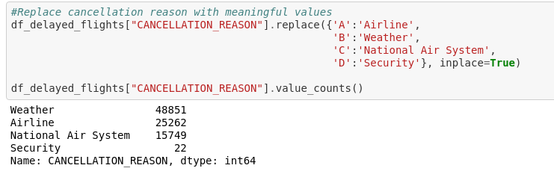
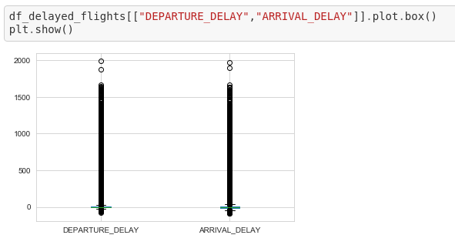
Data Cleaning
Cleaning involved:
Merging columns
Removing irrelevant and duplicated columns
Renaming columns
Change date and time format convert from 'HHMM' string to datetime.time
Replace Cancellation Reason with a description
Remove missing values
Remove outliers

Slide 7
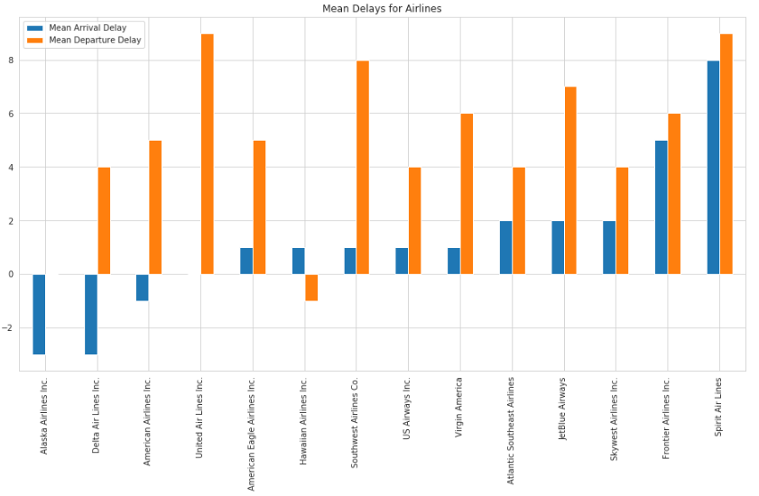
Visualization
Exploring the data involved:
Plotting numeric and categorical variables
Answer specific business questions relevant to the data set such as:
What is the average delay for each airline ?
What is the average arrival and departure delay times based on airport ?
What is the impact of the weather on flights?

Slide 8
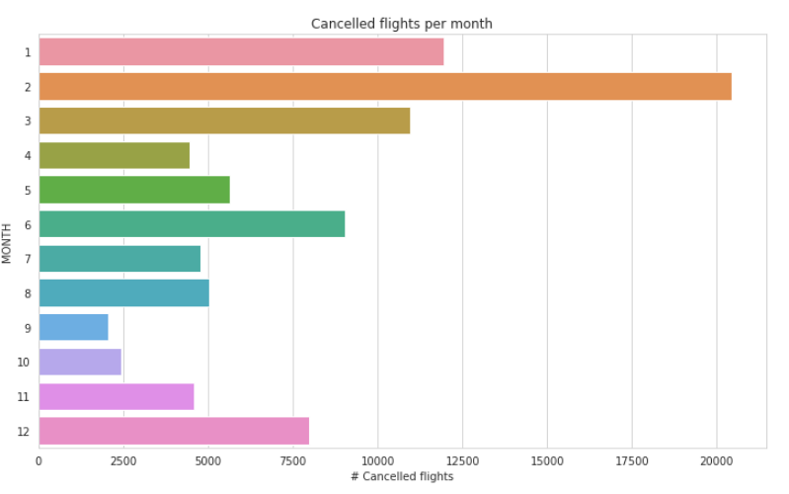
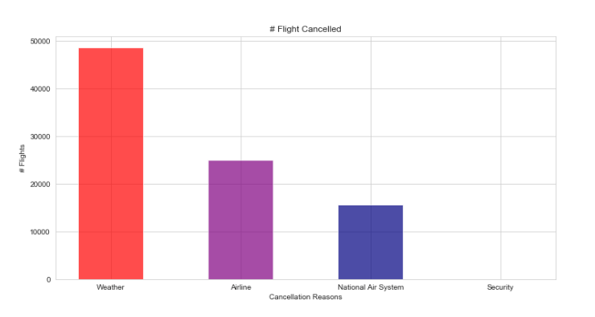
Visualization
Exploring the data involved:
Plotting numeric and categorical variables
Answer specific business questions relevant to the data set such as:
What is the average delay for each airline ?
What is the average arrival and departure delay times based on airport ?
What is the impact of the weather on flights?

Slide 9
Modelling

Slide 10
Results

Slide 11

Next Steps

Slide 12
Passenger
Business Conclusions
Airline
Airport Authority

